Slide 1







BUSINESS INTELLIGENCE WITH POWER BI
Module 7: Loading, Modelling and Dashboards
Data Modelling
and Relationships
Topic 2 of 6

Slide 2



By the end of this topic, the trainee can…
◇
!
Build
Explain
a data model with correct relationships between fact and dimension tables.
why a flat single table is often the wrong design, using a worked failure.
Notes:
1.7.2013
‹#›

Slide 3
SwiftRoute has 68 riders.
68
41,280
What the HR list says
What the dashboard reported
The chart had a title, an axis label and a legend. It was still wrong.
How would you have caught it?
?
Notes:
1.7.2013
‹#›

Slide 4
01
PART ONE
The failure
Watch a flat table produce a confident wrong answer
Understand why the grain changed underneath you
See the three costs, only one of which is obvious
Notes:
1.7.2013
‹#›

Slide 5
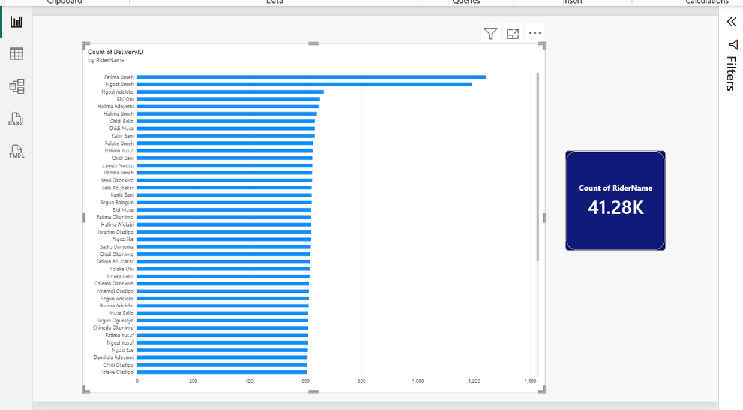
Watch this break
LIVE DEMO
WHAT YOU ARE SEEING
One table. Somebody joined all five SwiftRoute files together in Excel before importing, producing one wide table of 41,280 rows.
It loaded without a single error. Every visual builds. Nothing warns you.
“That is 41,280. We have 68 riders.” Let it sit for a moment before you say anything.
Notes:
1.7.2013
‹#›

Slide 6
The rider is not a rider. It is a rider-per-delivery.
DeliveryID
RiderID
RiderName
Hub
Fatima appears 617 times, once for every delivery she made in 2025.
!
D-000019
R-014
Fatima Abubakar
Ikeja
D-000001
R-002
Chioma Okonkwo
Ikeja
D-000239
R-014
Fatima Abubakar
Ikeja
Counting rows in that column does not count riders. It counts deliveries wearing rider names.
The number is not corrupt and it is not a bug. Power BI answered exactly the question you asked. You asked the wrong question.
D-000369
R-014
Fatima Abubakar
Ikeja
D-000002
R-003
Ngozi Yusuf
Lekki
D-000495
R-014
Fatima Abubakar
Ikeja
The grain changed. In a flat table the grain is one row per delivery, so every question it answers is a question about deliveries, whether you meant that or not.
Notes:
1.7.2013
‹#›

Slide 7
Duplication is only the visible cost
1
Wrong counts
2
Wrong averages
3
Impossible filters
Any distinct thing living in the fact table gets counted at delivery grain. Riders, routes, customers, all inflated.
Average rider tenure, weighted by how many deliveries each rider happened to make. Busy riders dominate a statistic that should treat every rider equally.
A slicer on Hub filters deliveries, not riders. You can never ask “how many riders in Apapa made no deliveries last week”, because those riders do not exist in this table at all.
The third one is the killer. A flat table cannot represent something that did not happen.
Notes:
1.7.2013
‹#›

Slide 8
02
PART TWO
The fix
Separate events from things: fact and dimension
Draw the star and read every relationship
Ask the same question again and get 68
Notes:
1.7.2013
‹#›

Slide 9
Two kinds of table, two different jobs
▤ FACT TABLE
◎ DIMENSION TABLE
Records events. One row per thing that happened.
Long and narrow: many rows, few columns, mostly numbers and IDs. It grows every day.
Describes things. One row per thing that exists.
Short and wide: few rows, many descriptive columns, mostly text. It changes rarely.
swiftroute_deliveries
41,280 rows and growing
riders (68) · routes (24)
customers (310) · dates (365)
Rule of thumb: if you would filter or group BY it, it belongs in a dimension. If you would sum or count it, it belongs in the fact table.
Notes:
1.7.2013
‹#›

Slide 10
The SwiftRoute star
riders
routes
RiderID
1
1
RouteID
RiderName
RouteName
Hub
RiderID
RouteID
DistanceKm
VehicleType
∗
swiftroute_deliveries
∗
ZoneTier
DeliveryID
RiderID · RouteID
CustomerID · DateKey
DeliveryFee · Status
∗
∗
customers_business
CustomerID
DateKey
dates
CustomerID
DateKey
BusinessName
1
1
MonthName
Sector
Quarter
IsWeekday
1 one side (dimension) ∗ many side (fact)
Four dimensions, one fact. Filters flow inward, from the outside of the star to the centre.
Notes:
1.7.2013
‹#›

Slide 11
One rider, many deliveries
ONE side · riders
MANY side · swiftroute_deliveries
R-014 Fatima Abubakar
D-000019
R-014
1
∗
R-022 Aisha Adeleke
D-000037
R-022
D-000239
R-014
R-041 Emeka Nwosu
D-000031
R-041
D-000369
R-014
D-000125
R-022
The ONE side must hold each key exactly once. The MANY side may repeat it freely. That is not duplication, that is the whole idea.
Notes:
1.7.2013
‹#›

Slide 12
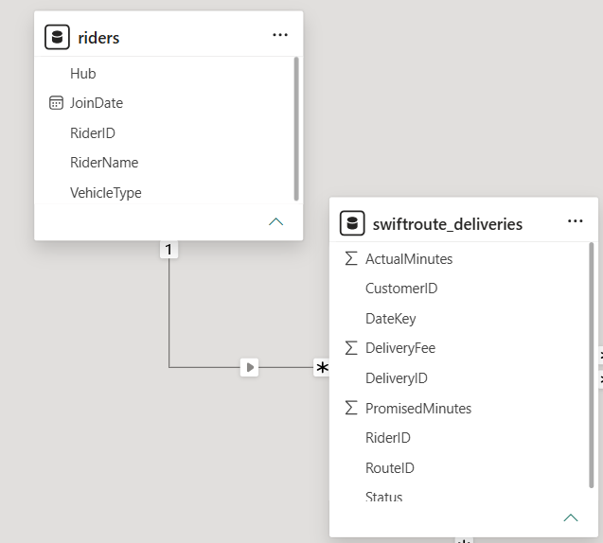
Drawing a relationship in Model view
1
Open Model view
2
Drag key to key
3
Confirm cardinality
4
Check the filter arrow
READ, DO NOT CLICK THROUGH
Drag RiderID from riders onto RiderID in deliveries. Power BI infers the cardinality and shows it.
Read what it inferred. An unexpected many-to-many is almost always a data quality problem in the dimension, not a modelling decision.
The Create relationship dialogue: riders.RiderID to
swiftroute_deliveries.RiderID, One to many, Single direction
Drawing a relationship in Model view
Notes:
1.7.2013
‹#›

Slide 13
Read every relationship before you trust it
⇄
Cardinality
Should be one to many, with the “one” on the dimension. Many-to-many means your dimension has duplicate keys.
→
Cross-filter direction
Should be Single, flowing from dimension to fact. “Both” is available and is almost always the wrong choice for a beginner.
◌
Active or inactive
A dotted line means the relationship exists but is not being used. Power BI allows only one active path between two tables.
Ninety percent of “my numbers are wrong” problems in Power BI are one of these three. Photograph this slide.
Notes:
1.7.2013
‹#›

Slide 14
Both directions feels helpful. It is not.
SINGLE · filters flow one way
BOTH · filters can travel back up
riders
routes
riders
routes
deliveries
deliveries
Setting cross-filter to Both lets filters travel back up from the fact into the dimension, then across into other dimensions. It solves the problem you were poking at and creates ambiguity everywhere else, because Power BI can now reach the same table by more than one path and has to pick one.
The symptom appears weeks later, in a different visual, as a number that is quietly wrong.
Notes:
1.7.2013
‹#›

Slide 15
Every model needs a date table. Yours already has one.
dates.csv · 365 rows
It looks redundant, because deliveries already has a date column. It is not.
A dimension table for dates is what lets you say “compare this month with the same month last year” in a single measure. Without it, every time comparison becomes a hand-built filter, and the CALCULATE example in the next topic does not work at all.
Year · Quarter · MonthName · WeekNumber · IsWeekday
✓
Table tools › Mark as date table › choose DateKey.
Do this before you write any time-based measure.
In about forty minutes you will write a measure that compares month on month, and it will be one line because of this table.
Notes:
1.7.2013
‹#›

Slide 16
The same question, asked of a proper model
FLAT TABLE
STAR SCHEMA
41,280
68
Correct answer to a question nobody asked
The riders dimension has 68 rows, so counting it counts riders
Notice what did not change. The data is identical. The visual is identical. The only thing that changed is which table the count is drawn from, and that was decided by the model, not by the chart.
The model is where correctness lives. The chart just shows you what the model believes.
Notes:
1.7.2013
‹#›

Slide 17
Build the star
YOUR TURN
THE TASK
Open 7.2_practice_unlinked.pbix. All five SwiftRoute tables are loaded with no relationships. Build all four, set every cross-filter direction to Single, and mark dates as the date table.
EXPECTED OUTPUT
Four solid lines in Model view, no dotted lines, every relationship reading One to many with the “one” on the dimension. A card counting riders returns 68. A card counting routes returns 24.
Predict first. Write down what a count of customers will return before you build it.
Notes:
1.7.2013
‹#›

Slide 18
Why the routes relationship refused
In routes.csv
In deliveries.csv
“LAG-07·”
“LAG-07”
trailing space, invisible on screen
clean
To you these are the same route. To Power BI they are two different text values, so the relationship either fails to match or matches only some rows. Nothing turns red. The join produces blanks, and you read the blanks as missing data.
The fix is upstream, in Power Query: Transform › Format › Trim.
Not in the model, and never by editing the source file by hand.
↑
Notes:
1.7.2013
‹#›

Slide 19
The honest caveat
⚖
A single table is not always wrong. If you have one source, no dimensions worth describing separately, no time intelligence and no counts of distinct things, a flat table is simpler, and simpler is a real virtue. Plenty of good reports are one table.
The claim in this topic is narrower, and it is the one your outcome asks you to explain: a flat table is the wrong design when you need to count or filter by things rather than events. Know which situation you are in, and be able to say why.
A trainee who says “flat tables are always bad” has learned a slogan, not a skill. This nuance is fair game in the formative check.
Notes:
1.7.2013
‹#›

Slide 20

Topic Recap
Build a data model with correct one-to-many relationships, and check cardinality, direction and active state.
✓
Up Next:
DAX fundamentals
Explain why a flat single table is often the wrong design, with a worked failure you watched produce a plausible wrong number.
✓
Fix a broken relationship upstream in Power Query rather than patching it in the model.
✓
You have seen a chart that was beautifully labelled and completely wrong. Remember how that felt.
Notes:
1.7.2013
‹#›

Slide 21
What is Next
TOPIC 7.3
IN THE LAB
ON PUBLICA.ACADEMY
ƒ
▣
?
The model knows the structure. Now you teach it to calculate. Three DAX measures cover most real dashboards.
Repair a model with three deliberate faults: a bidirectional relationship, a many-to-many caused by duplicate keys, and an inactive relationship nobody noticed.
Practice questions on cardinality and filter direction, using the SwiftRoute star.
Notes:
1.7.2013
‹#›

